Slide 1
Sample Examination PowerPoint:
  To practice navigating, place the Sample
PowerPoint in presentation mode and
advance to slide two.
  Click on the grey boxes and blue arrows
to advance to different slides.

Slide 2
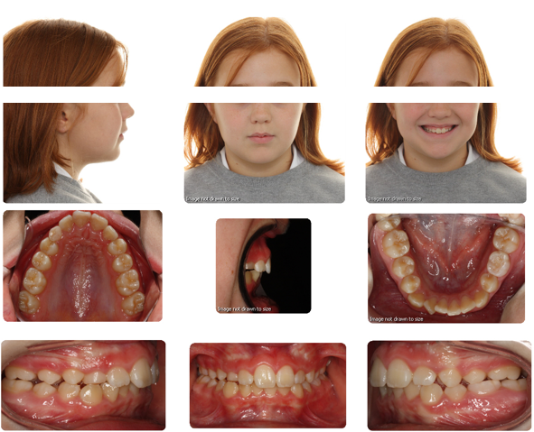
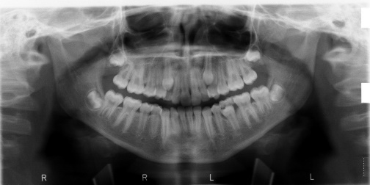
Slide 1
PRE TX
Slide 2
PRE TX
PART 2 RECORDS
PART 3 RECORDS

Slide 3
BACK
BACK
BACK

Slide 4

BACK
BACK
BACK

Slide 5
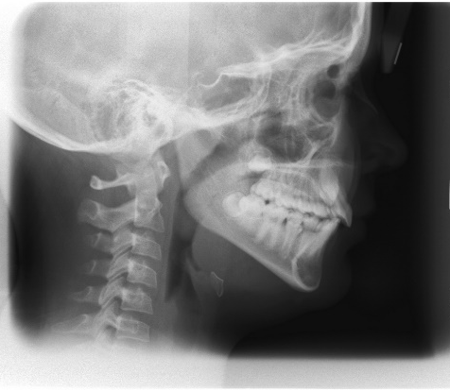
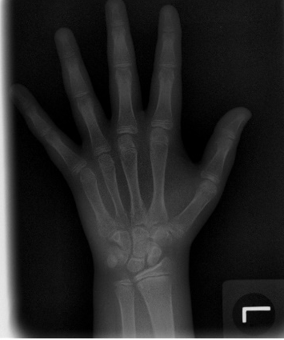
Slide 1
PRE TX
Slide 2
PRE TX
PART 3 RECORDS
PART 1 RECORDS

Slide 6
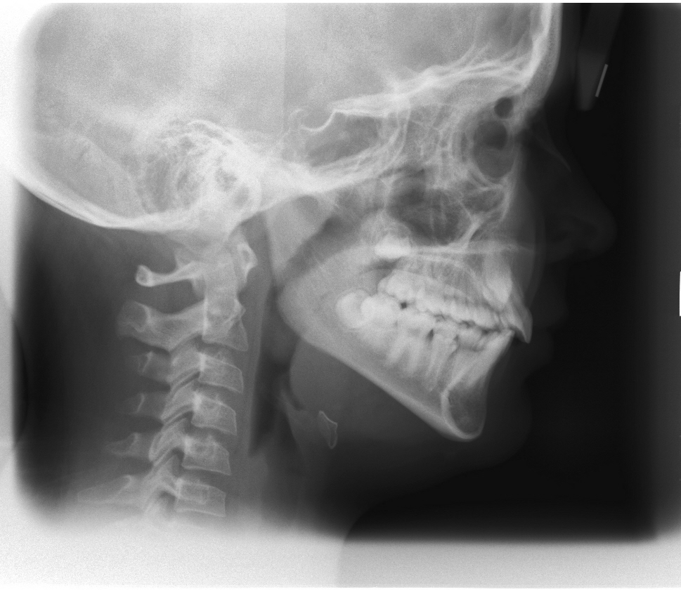
BACK
BACK
BACK

Slide 7

BACK
BACK
BACK

Slide 8
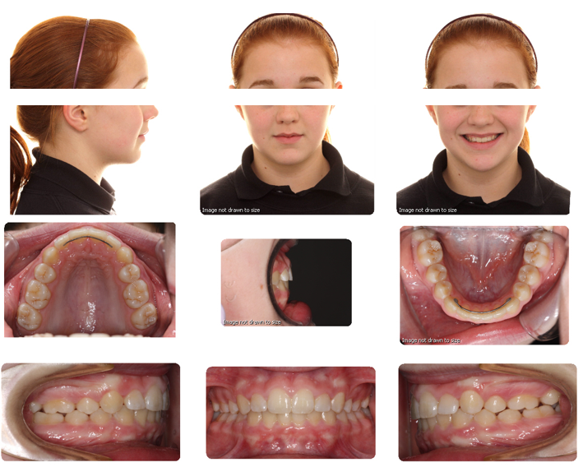
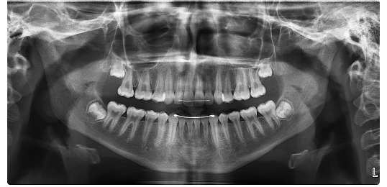
Slide 1
POST TX
Slide 2
POST TX
PART 1 RECORDS
PART 2 RECORDS

Slide 9
BACK
BACK
BACK

Slide 10
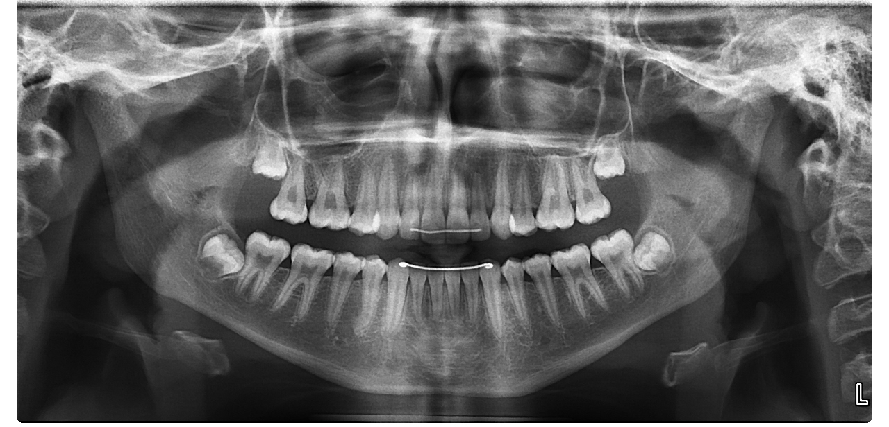
BACK
BACK
BACK

